Slide 1

Il ruolo dell’anestesista e protocollo ERAS in un centro ad alto volume
Dott.sa Chiara Ferrari
Head f NORA, Ambulatory and Bariatric Anesthesia

Slide 2
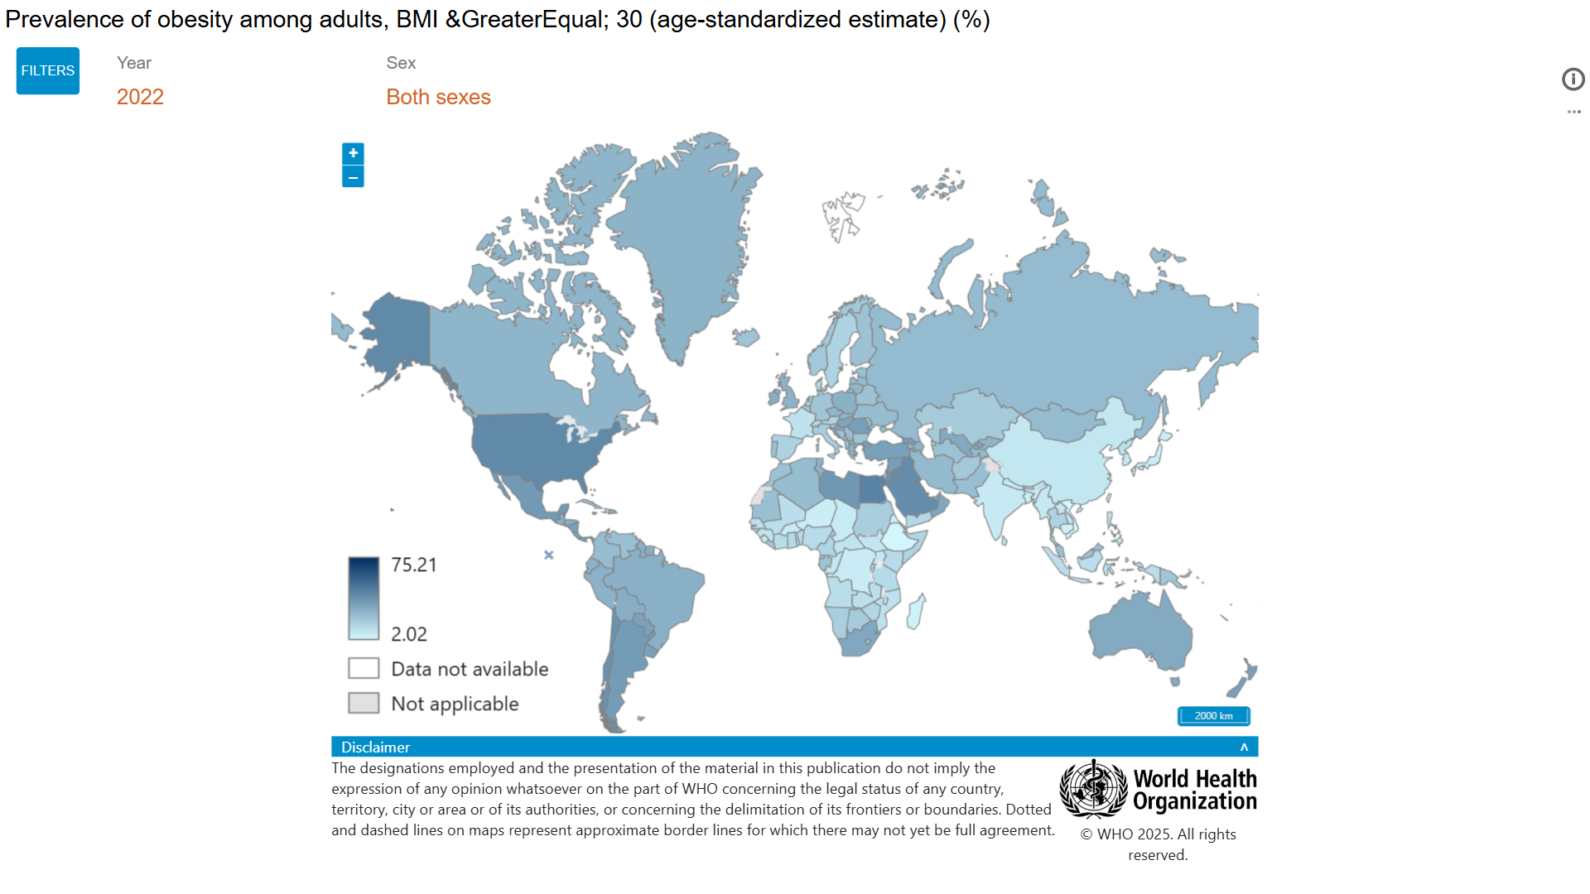
Worldwide, the prevalence of obesity has nearly tripled in the past 40 years
As the prevalence of obesity increases worldwide, an increasing number of obese surgical patients will require anesthesia
24%
26%
42%
30%
Anesthetists must be able to confidently manage the associated pathophysiological and technical challenges.
HIGH RISK PATIENTS – INCREASED PERIOPERATIVE RISK

Slide 3
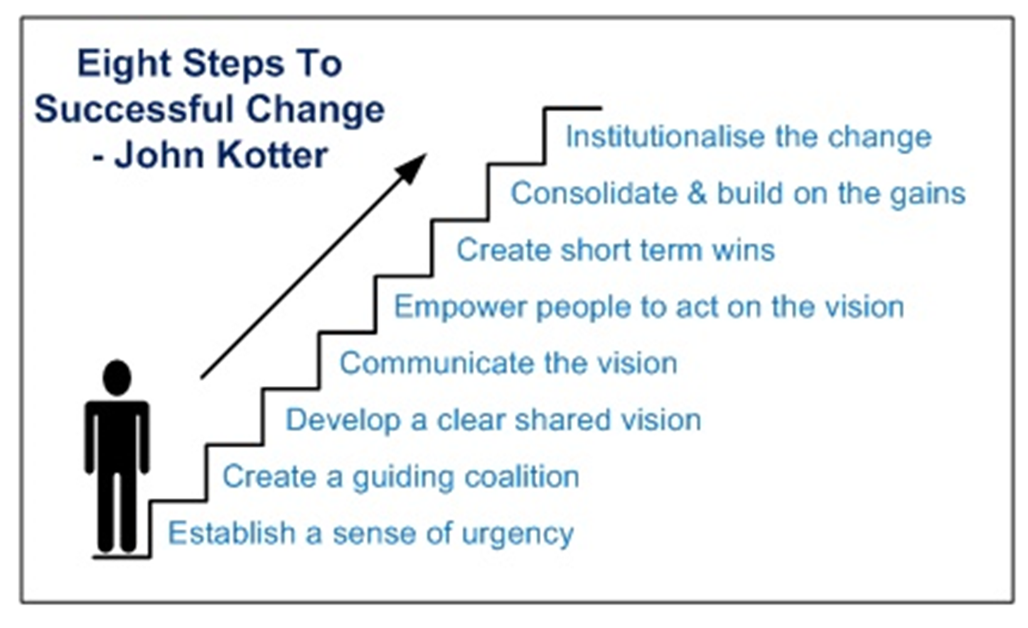

Slide 4

July 2015
Why me?

Slide 5
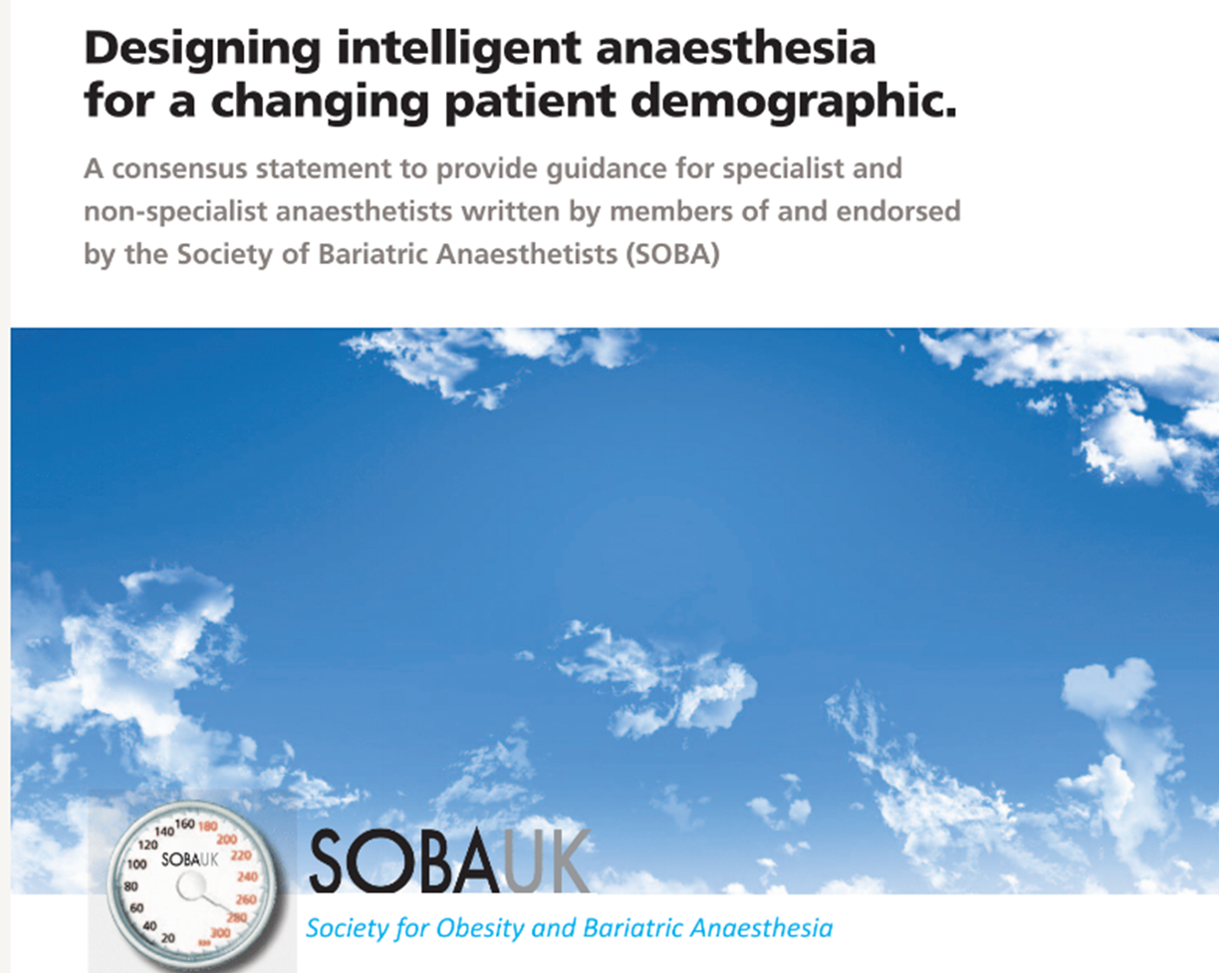
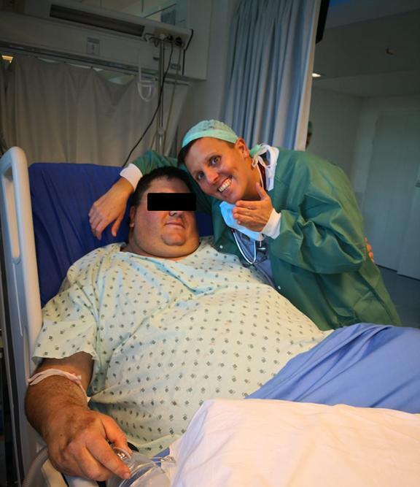
2013
or lucky?

Slide 6


From Zero to Everest in…
1stJuly 2015 – 1st May 2025
9538 Pts (8456 sleeve)
BMI 44.3 ± 3
F 74%
Age 40
OSAS (CPAP) 16%
10 Years
Bariatric Surgery

Slide 7
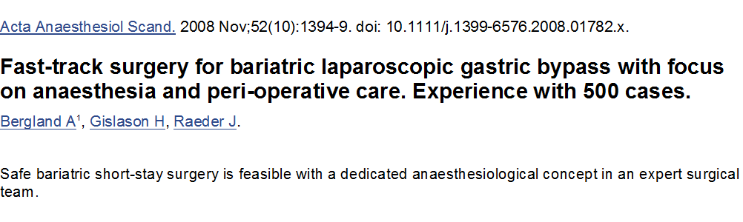

Slide 8

Anesthesia plays a crucial role
_{in the implementation of}
Enhanced Recovery After Bariatric Surgery (ERABS)

Slide 9

Life threatening comorbidities
Difficult airway
Postoperative respiratory complications
useful peri-operative strategies include
avoidance of general anesthesia and sedatives where possible

Slide 10
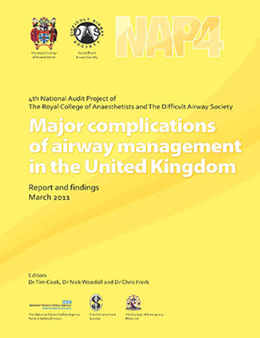
«there was often a lack of recognition and planning for potential airway problems»

Slide 11
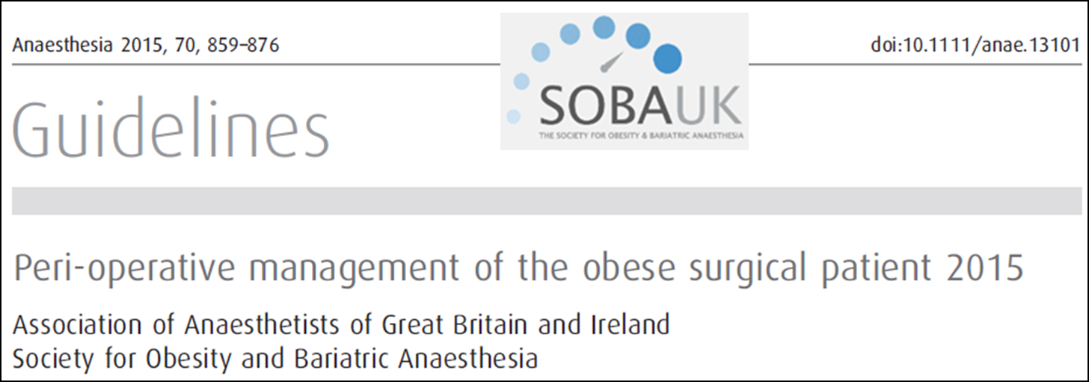
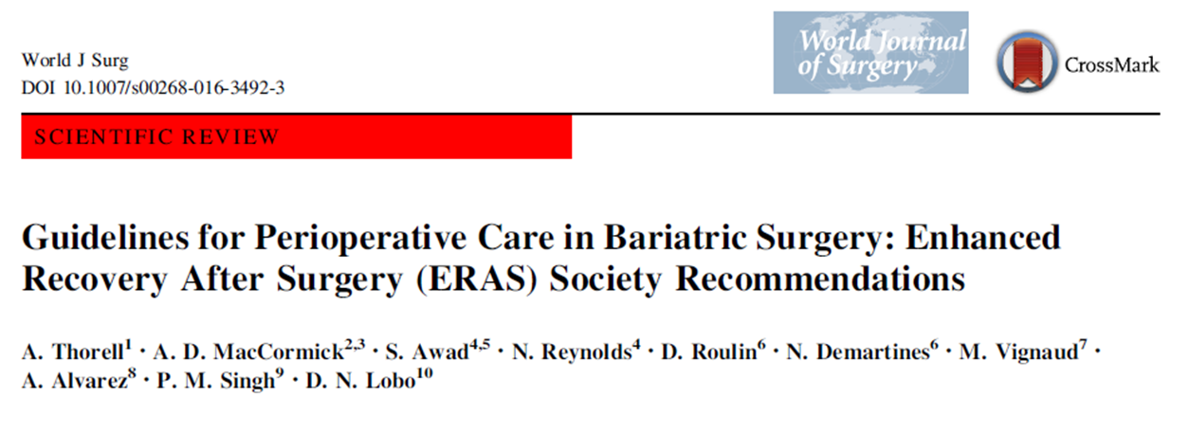

Slide 12
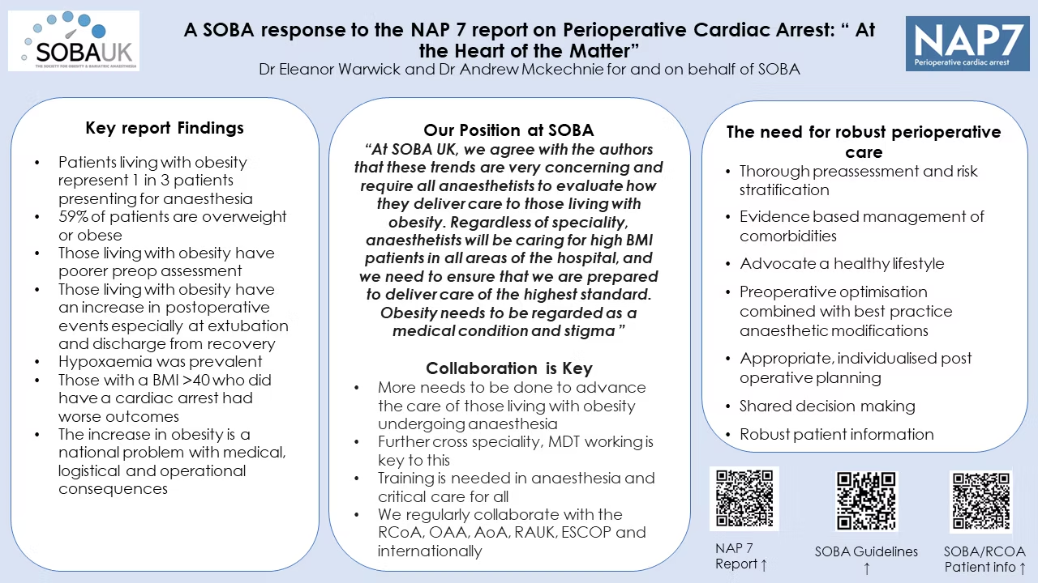
Almost 10 years later…
“for those living with obesity, there is not a “one size fits all” approach and all patients should be considered individually, thoroughly assessed preoperatively, experience shared decision making and have a plan for post operative destination made on the basis of the patients need and the surgery itself.”
2023

Slide 13
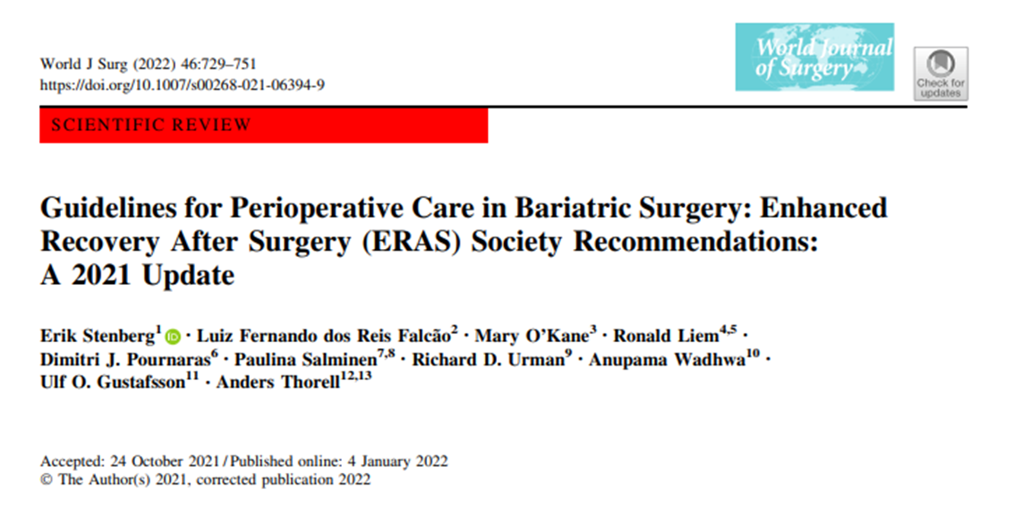
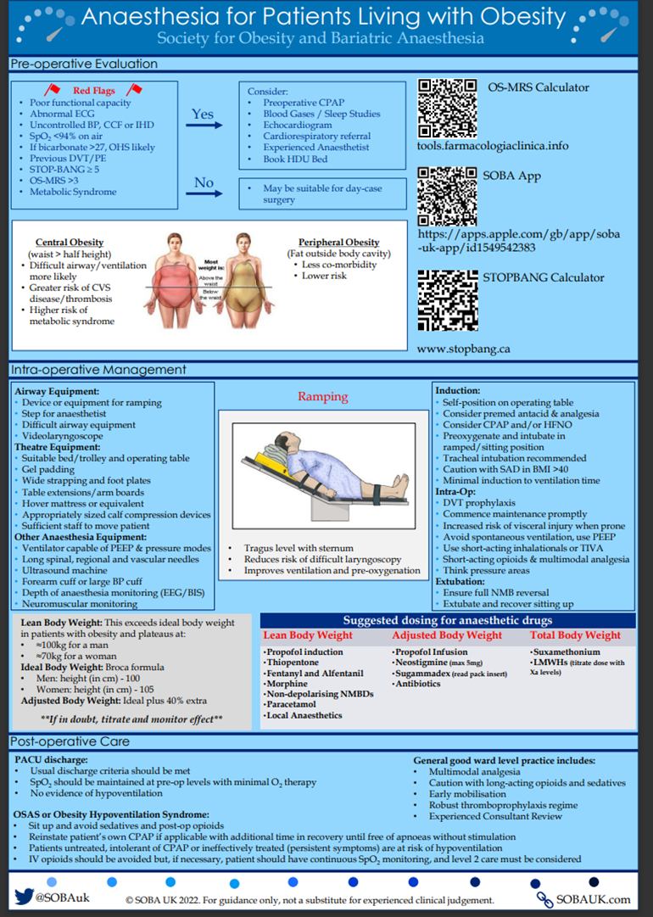
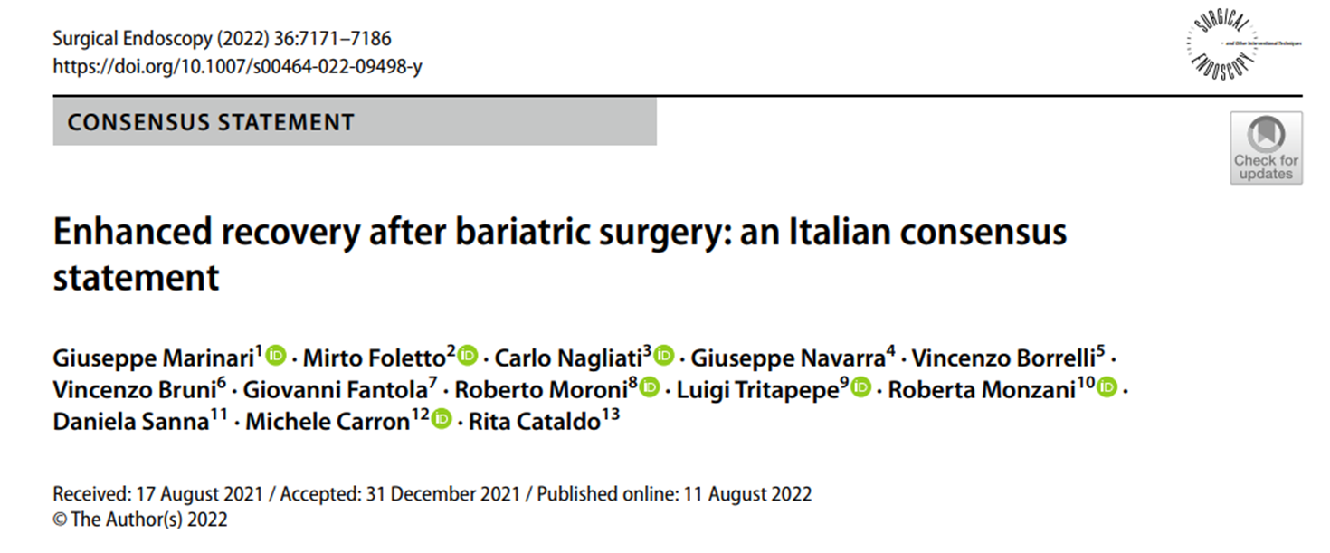

Slide 14
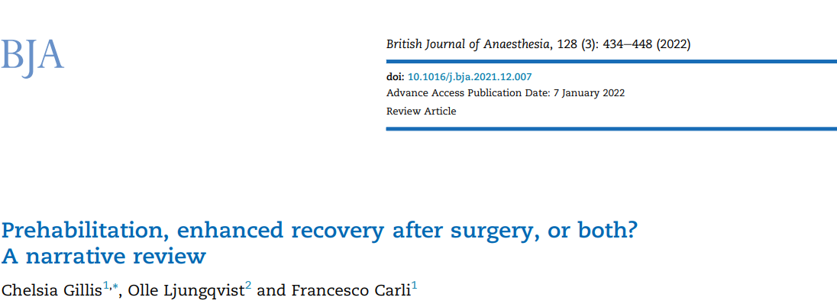
We propose that the process of surgical recovery begins before the incision and that preoperative patient characteristics mediate the surgical stress response and thus modify surgical outcomes.

Slide 15

Prepare for Surgery
Prevent disasters (planning, predictors and algorithms)
Measure & Monitor
Enhance Recovery
How to…?
Standardize & Customize
focus on the preoperative identification and optimisation of co-morbidities (prehab)
counsel patients and caregivers
appropriate equipment in the operating theatre
predictors and algorithms for airway management
a dedicated plan for postoperative disposition
while there are published guidelines on the minimum monitoring standards for anesthesia and recovery there has been little published to date specific to the intraoperative monitoring of the obese patient.

Slide 16

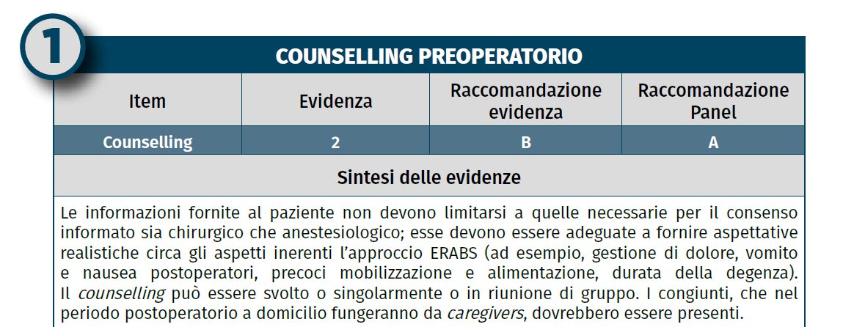

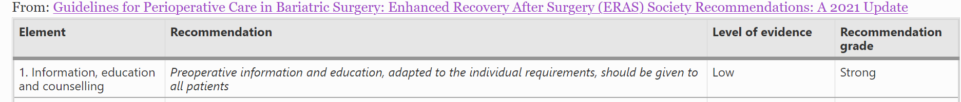
counsel patients and caregivers

Slide 17
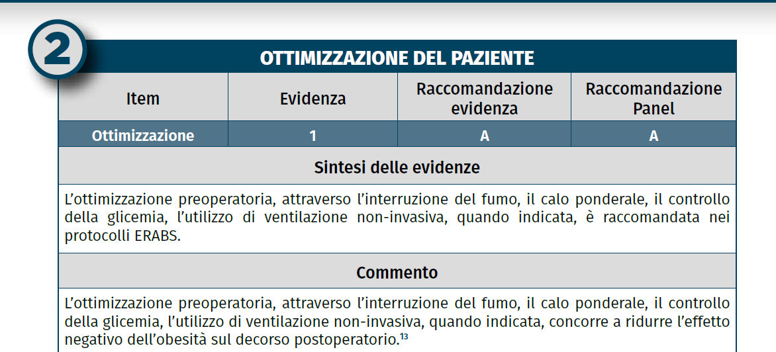
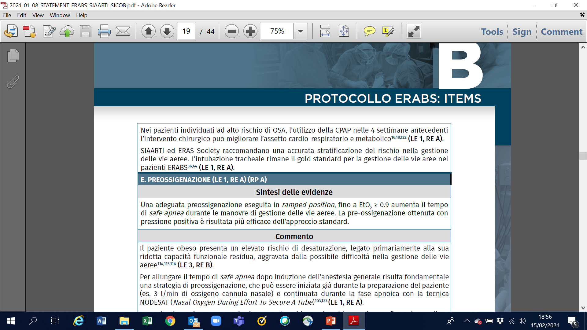
focus on the preoperative identification and optimisation of co-morbidities (prehab)

Slide 18
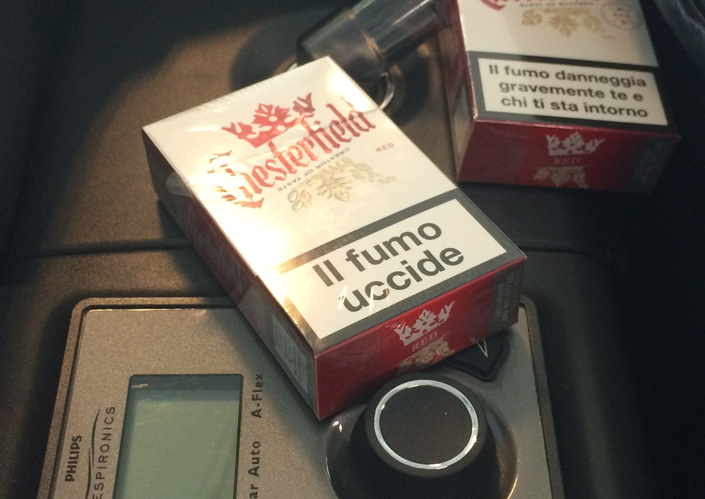

Slide 19
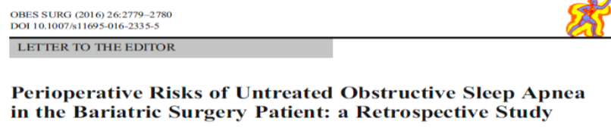
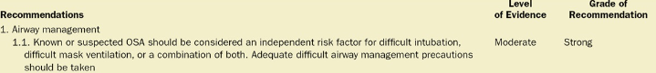
Are patients with OSA at increased risk for difficult airway management and do special precautions need to be taken?
Anesth Analg 2018;127(4):967–87.
Independent risk factor

Slide 20
60% incidence of OSA
(70% of patients with a BMI greater than 40 kg/m2)
90% of these patients were not aware of their OSA status prior to testing
OSA has been linked not only to adverse long-term health outcomes but also to increased perioperative risk
identifying patients at risk for OSA has been recommended → STOP-BANG questionnaire
Perioperative management of obstructive sleep apnea
in bariatric surgery: a consensus guideline.
Surg Obes Relat Dis 2017; 13:1095–1109.
Anesthesiology Clin 37 (2019) 215–224
Anesth Analg 2016;122:1321–34

Slide 21
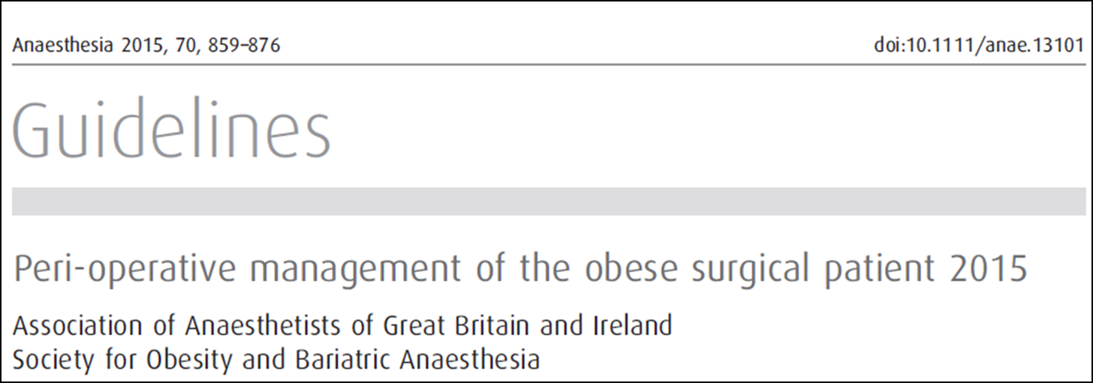
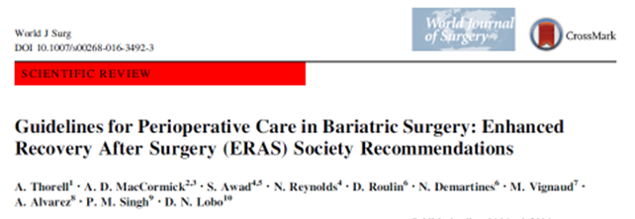
predictors and algorithms for airway management
Anesthetists should be aware of the specific difficulties in managing bariatric airway
Tracheal intubation remains the reference for airway management
planning
expertise

Slide 22
Modifications of the approach to general anesthesia in obese patients center largely on respiratory issues
OSA
OHS
HYPOXIA
HYPERCAPNIA
QUICK DESATURATION
the anticipation and management
of respiratory problems is critical
Premedication of the obese patient should ideally allow anxiolysis without abolishing airway reflexes or preventing patient cooperation prior to induction of general anesthesia

Slide 23
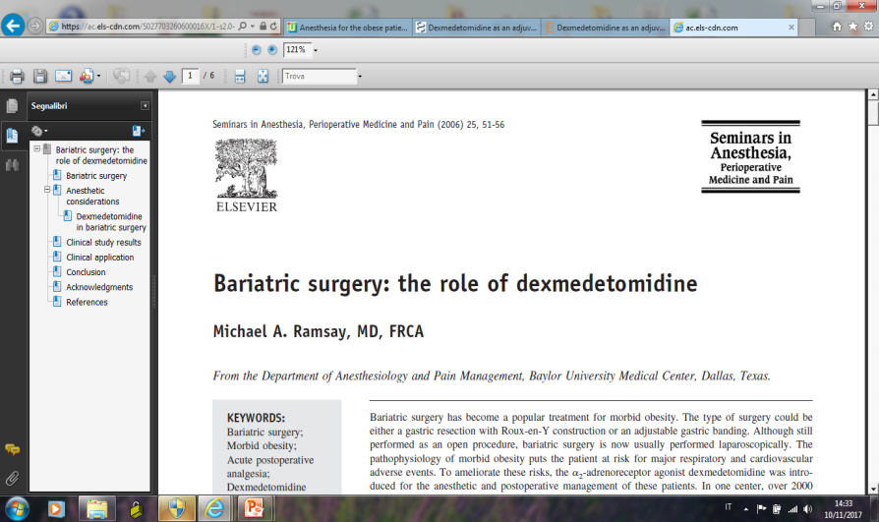
_{DEXMEDETOMIDINE}
sedative
analgesic
no respiratory depressant effects
THE GOLD STANDARD FOR PREMEDICATION IN OUR SETTING
Periop/intraop adjuvants

Slide 24
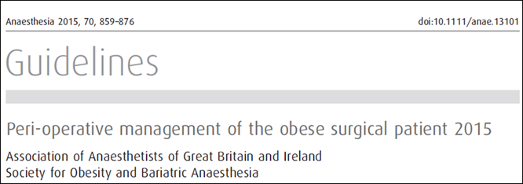
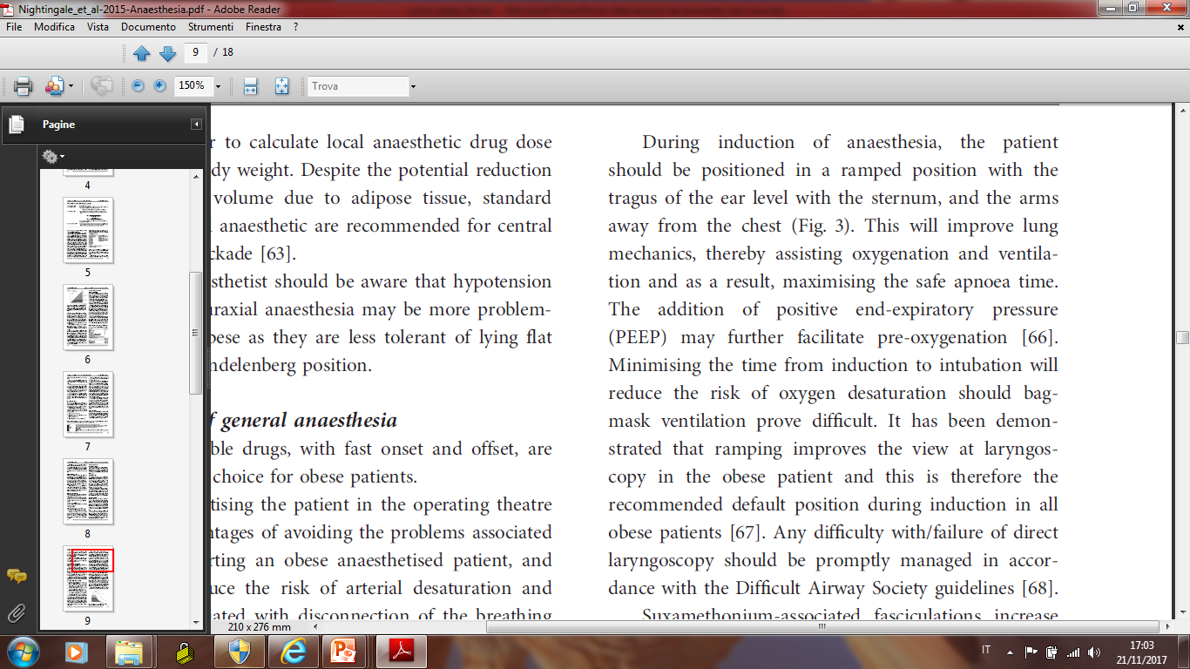
Parallel teamwork in theatre during positioning

Slide 25
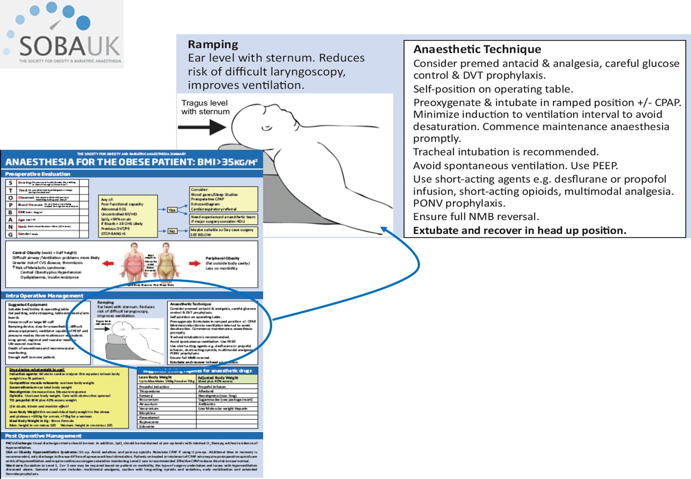

Slide 26
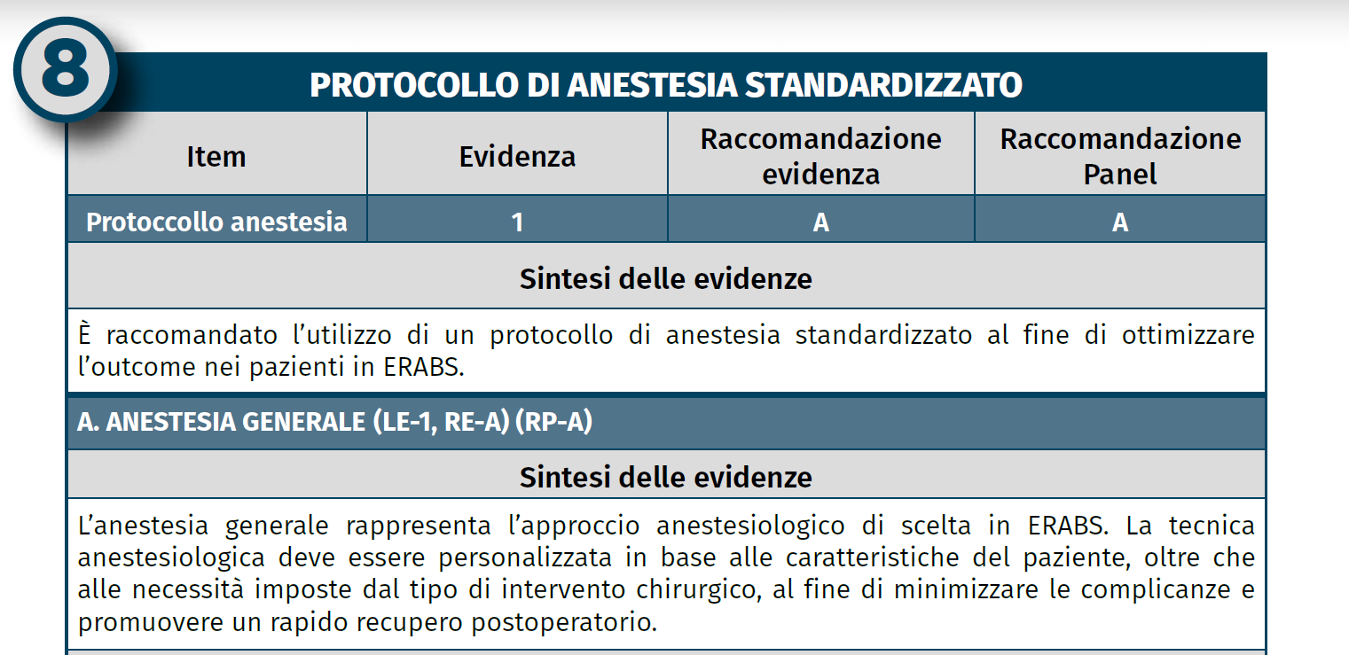

45 minutes before induction patients were premedicated with dexmedetomidine
(0,2 mcg/kg/h) continuous infusion
to grant mild sedation without losing airway protection and with an opiod sparing effect
Adjuvant agents
(lido/magnesium…)
TAP Block
Desflurane
Rocuronium
Sugammadex
SHORT ACTING
FULL REVERSAL

Slide 27
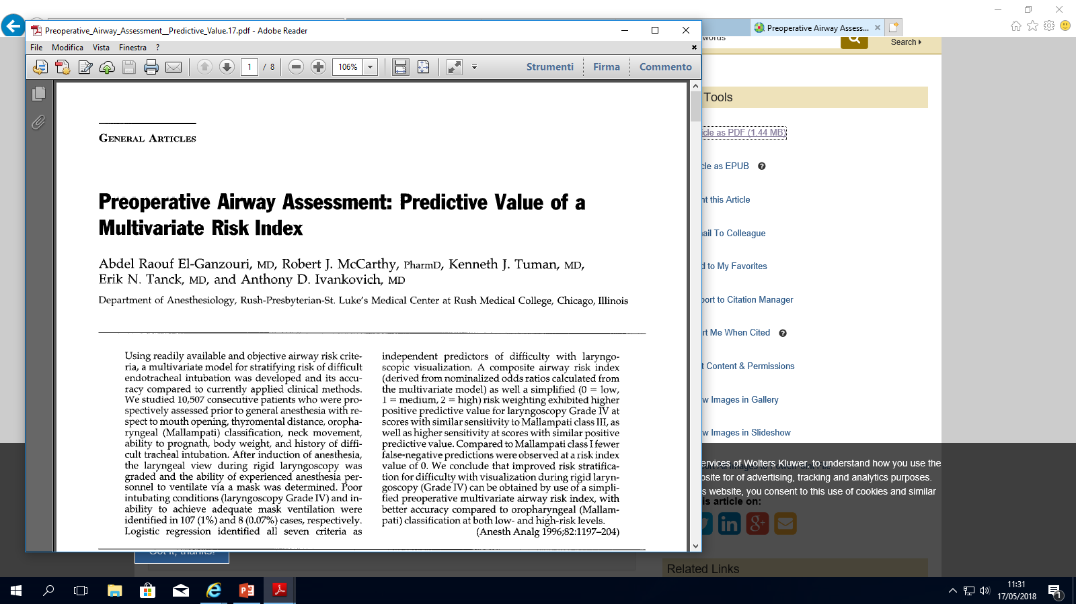
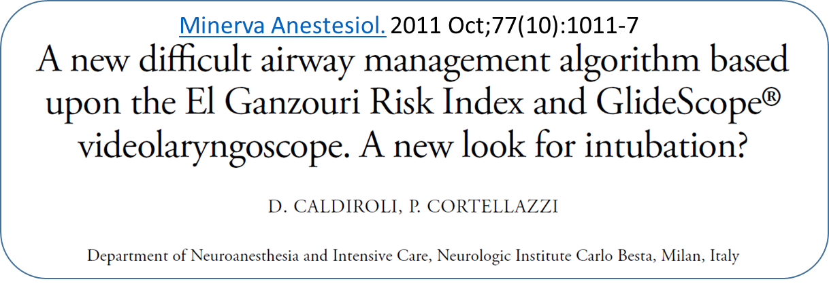
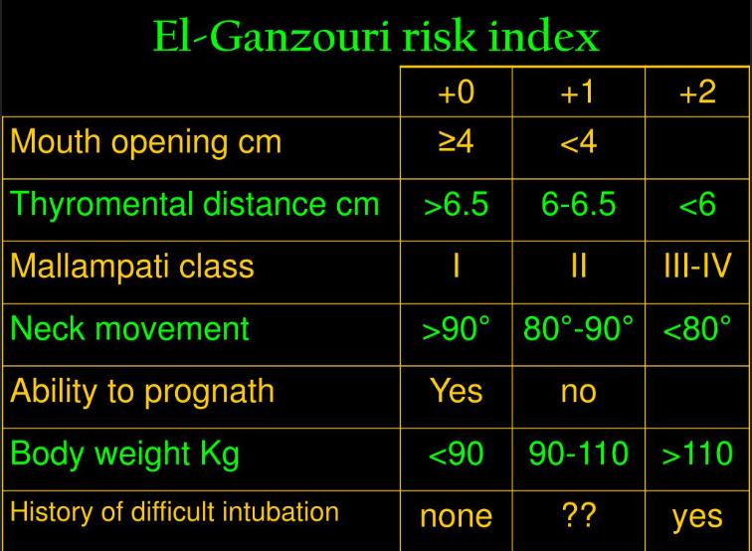
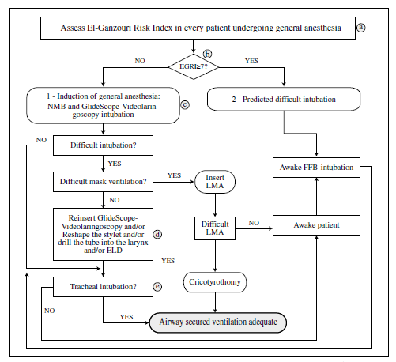

EGRI >= 4
likely difficult airway
EGRI
+
Glidescope®
EGRI >= 7

Slide 28
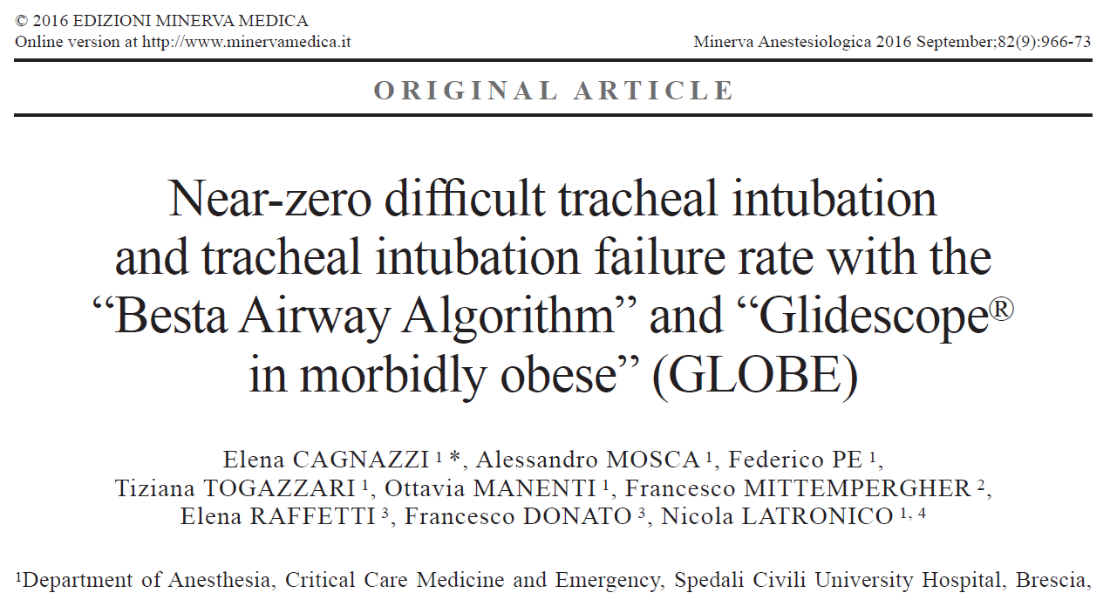
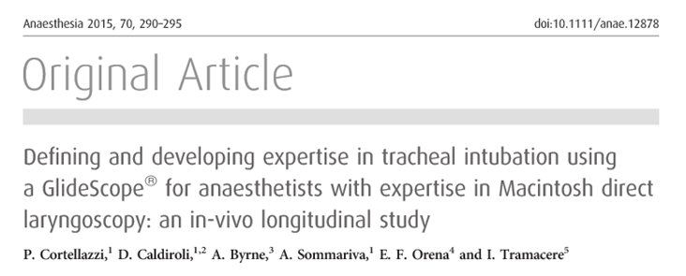
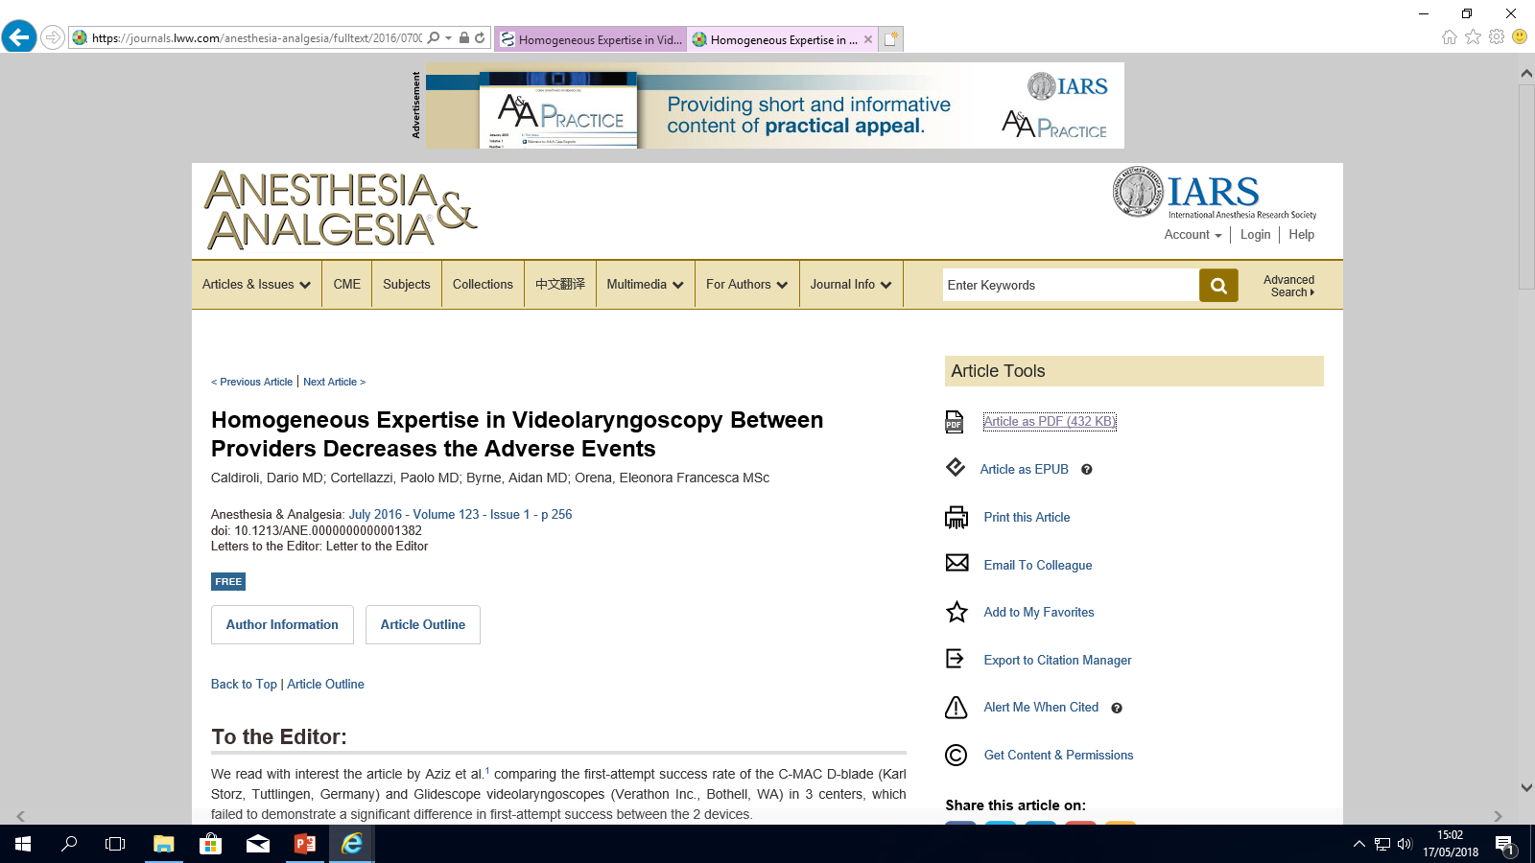
We implemented a structured approach to airway management based on systematic El Ganzouri Risk Index (EGRI) assessment as predictor of potential difficulty and routinely use of Glidescope® for intubation
If neck circumference >55 cm
consider Glidescope intubation
under dexmedetomidine sedation
without paralysis (spontaneous breathing)
> 76 intubations each

Slide 29
VENTILATION GRADE
(Han classification)
* p<0,0001 to neck circumference
1: 94%
2: 5%
3: 1%*
EGRI> 4 19 %
EGRI>=7 0,4%
none underwent fiberoptic intubation
Induction 4+/-1 min
(bolus → gastric tube)
no failures, 98% at first attempt
Cormack-Lehane Grade 1 95%
TIME TO CORMACK **
MEAN (sec) 12 +/-8
TOTAL TIME TO INTUBATION**
MEAN (sec) 32 +/-17
**not related to BMI
Safe extubation within 2 minutes since the end of surgery independently from time&type of surgery and BMI (p 0,01)
No residual curarization

Slide 30
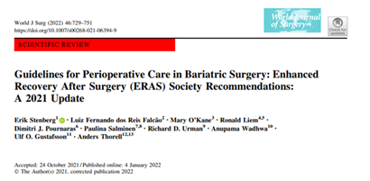
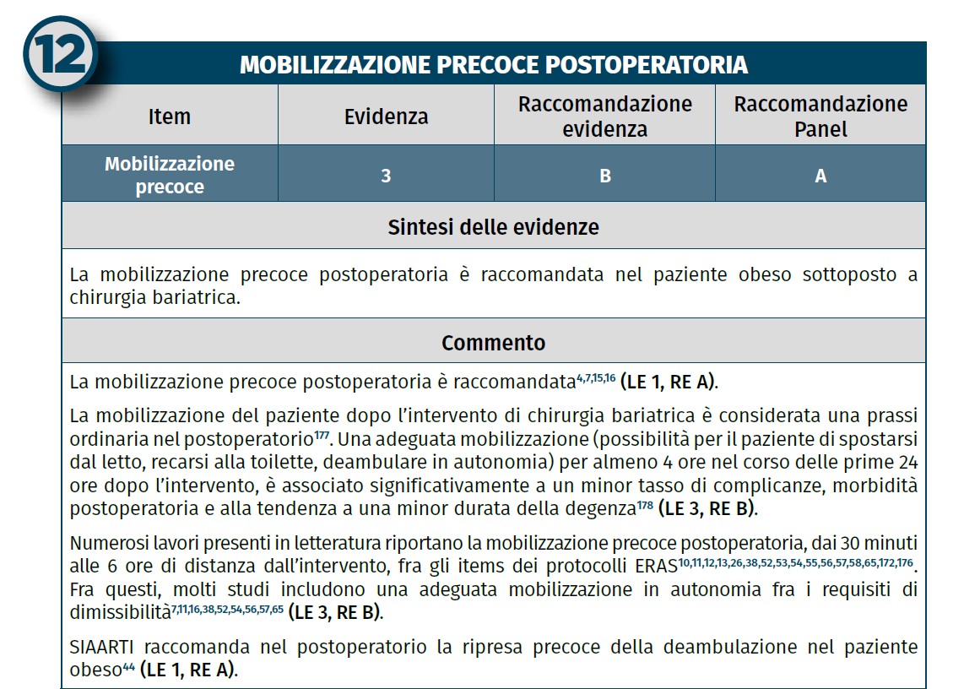

a dedicated plan for postoperative disposition
Full reversal to prevent PORC
CPAP (if OSA) and physio
Early mobilization*
Early fluid intake*
Opioid sparing analgesia
PONV prevention
* 30 minutes after surgery

Slide 31
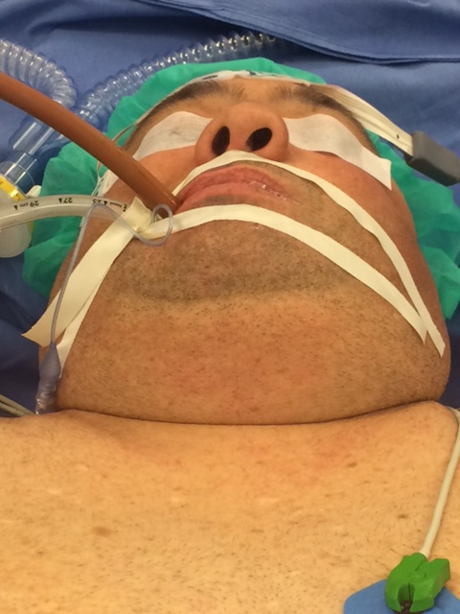
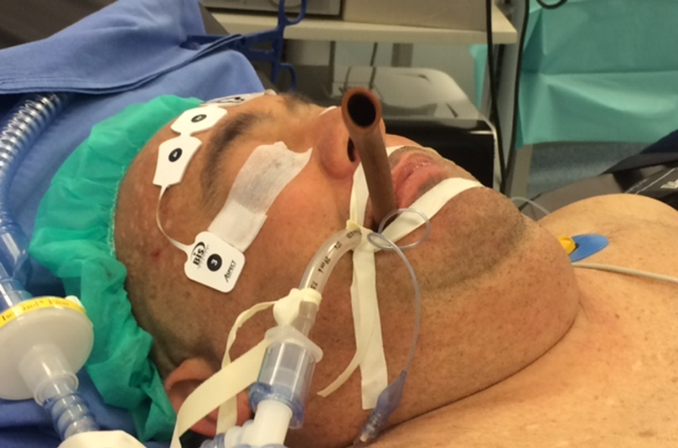
BMI 56
CPAP
CAD (PTCA +Stent)
EGRI 7
NC 54

Slide 32
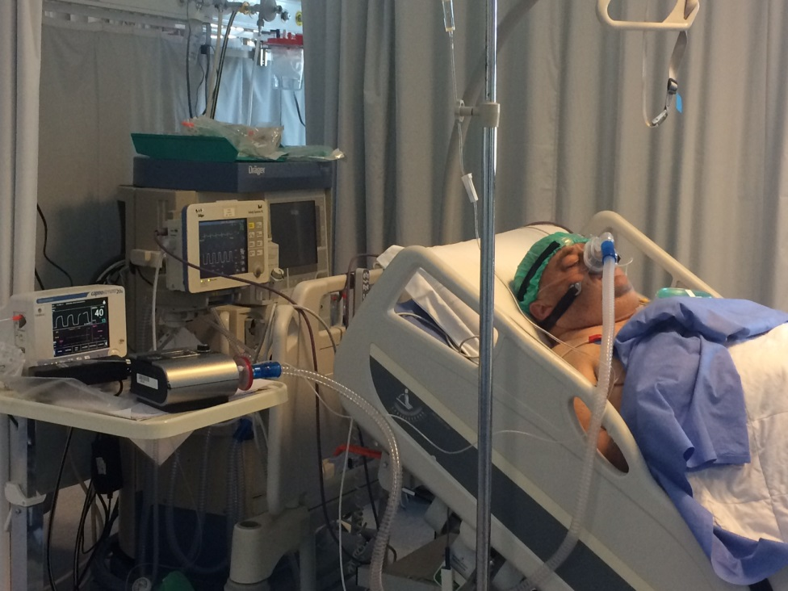
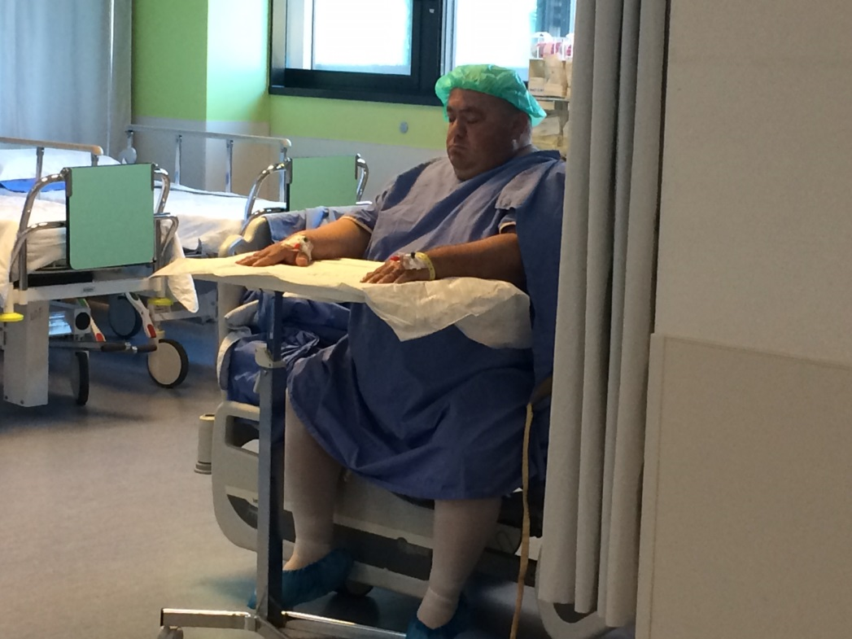

Slide 33
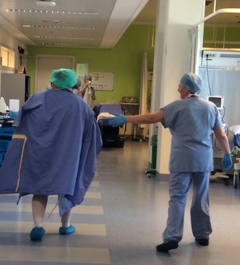
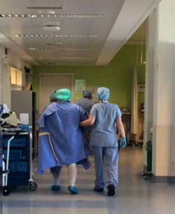

Slide 34
appropriate equipment in the operating theatre
Obesity leads to chronic sympathetic activation
Reduced parasympathetic tone and baroreflex sensitivity
Increased heart rate and blood pressure variability
Obesity affects autonomic nervous system (ANS) balance
Altered ANS responses influence pain perception and stress response
Implications for perioperative management and anesthetic care!

Slide 35
Continuous monitoring of vital signs, including blood pressure*, heart rate, and respiratory rate, is essential, along with….
*Non-invasive BP with proper cuff
*Arterial line for high-risk cases
EtCO2
Temperature (core**)
Depth of Anesthesia
Neuromuscular blockade monitoring
Assessing the patient's response to stimuli like surgical incision
**risk of inadvertent stapling or suturing of the temperature probe, nasogastric tube, or bougie during gastrectomy or gastrojejunostomy
All of them?
When?
Why?

Slide 36

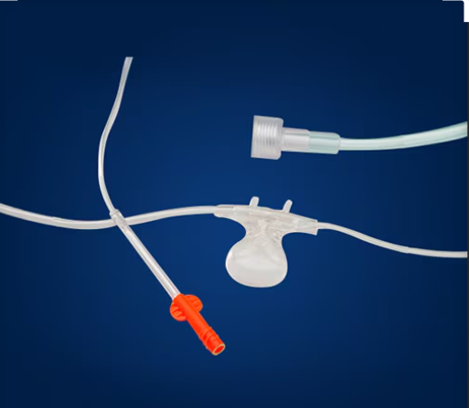
Promote innovation in monitoring end tidal carbon dioxide, measuring apnea and/or ventilation
EtCO2
ISPCOP Review Course Lecture 2019: Ambulatory Surgery in Morbid Obesity: Quo Vadis?
ERABS protocol
Preop evaluation 70% EtCO2 35 - 38 mmHg
Optimize comorbidities
OSAS detection and treatment
Safe Airway
PEEP
Protective Ventilation
Adjuvants (Lido/Dexmed)
Favourable Anesthetic Drugs
Reversal
Recovery Room: 75% EtCO2 35 e 41 mmHg 75% EtCO2 -3/+4 mmHg vs preop eval.
(ns)

Slide 37


Depth of Anesthesia
too deep can cause hemodynamic changes/adverse cognitive outcomes
too light carries the risk of recall or awareness
critical in fragile and high risk patients
ERABS protocol
using BIS for anesthetic depth guidance may lead to faster emergence and shortened stay in the recovery room
titrate your anesthesia path (anesthetics and body weight/pharmacokinetics)
customize anesthesia by measuring (safety)

Slide 38
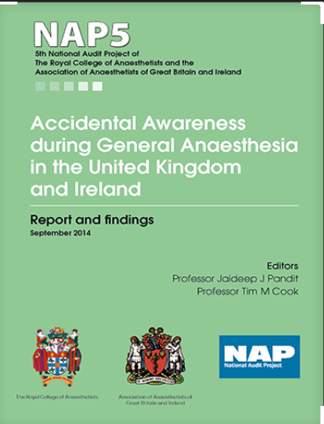

Neuromuscular Blockade
Deep neuromuscular blockade during laparoscopic bariatric surgery facilitates ventilation, provides stable surgical conditions, and is associated with less postoperative pain.
the combination of using muscle relaxants, without monitoring their effect, and without reversing them, incurred a risk for AAGA that was roughly 16 times greater
over three times as many obese patients experienced AAGA as non obese
the incidence of postoperative residual blockade is higher in the obese patient
TOF
complete recovery of neuromuscular function after general anesthesia is necessary because postoperative residual curarization (PORC) results in upper airway obstruction, hypoxia, and postoperative pulmonary complications
neuromuscular blockade should be assessed and reversed prior to extubation

Slide 39
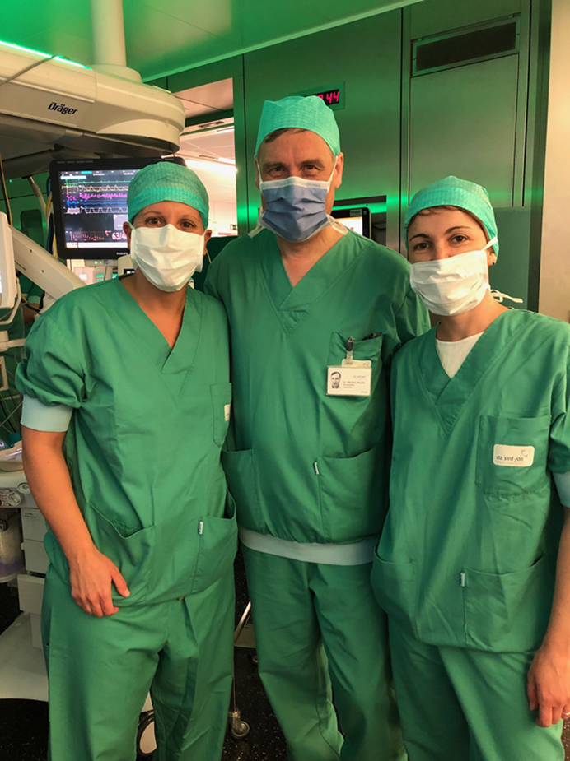
Assessing the patient's response to stimuli
Nociception in Bariatric Patients
Enhanced nociceptive sensitivity
Higher baseline inflammation and pain mediators
Standard hemodynamic markers may be unreliable
Clinical Impact of ANS Dysregulation
Increased perioperative cardiovascular risk
Greater intraoperative variability
Poorer control of pain and stress
Higher risk of opioid-related complications
Encourage the use of opioid sparing techniques when appropriate

Slide 40
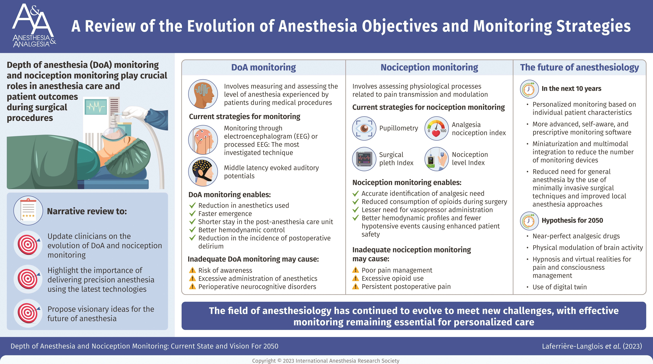
NOL®- Guided Analgesia: Why It Matters
Objective nociception assessment
Opioid-sparing strategy
Prevents sympathetic overactivation
Enhances hemodynamic stability
Reduces post-op respiratory complications

Slide 41
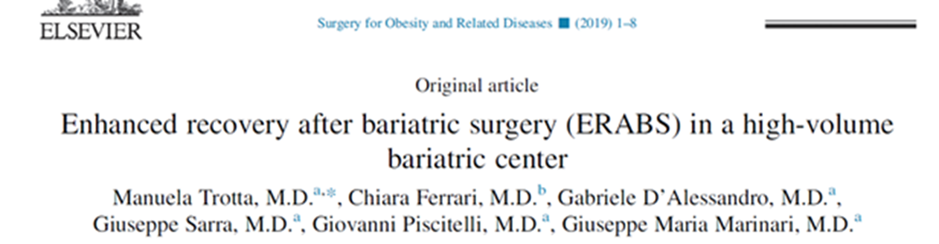
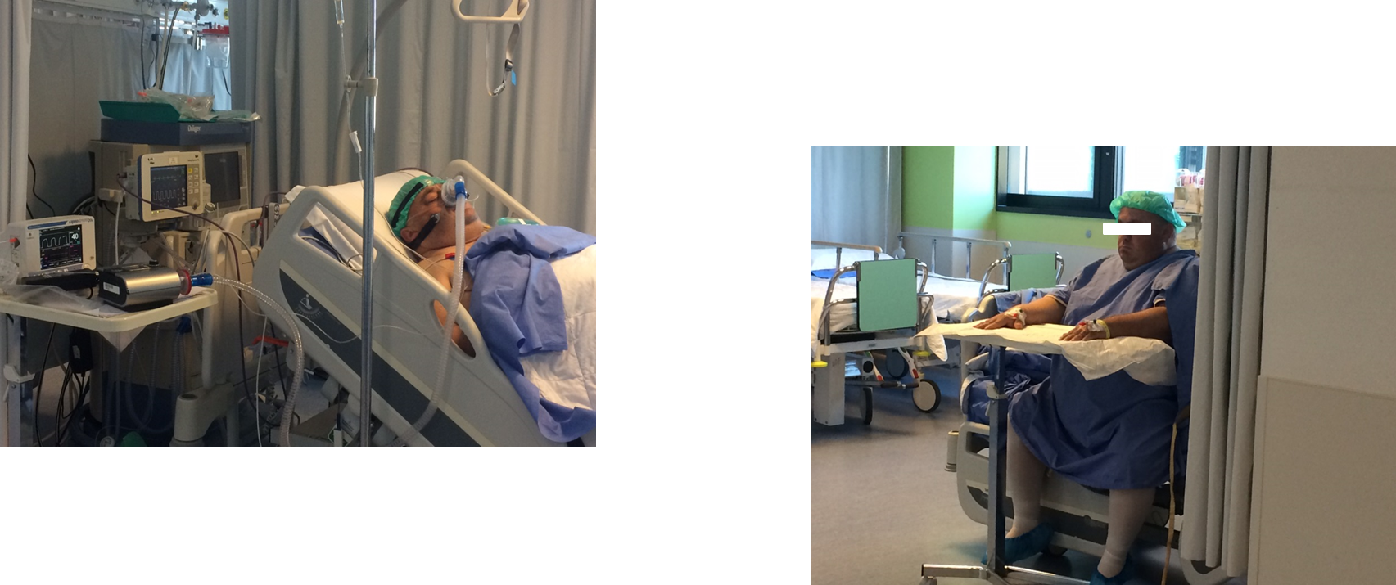
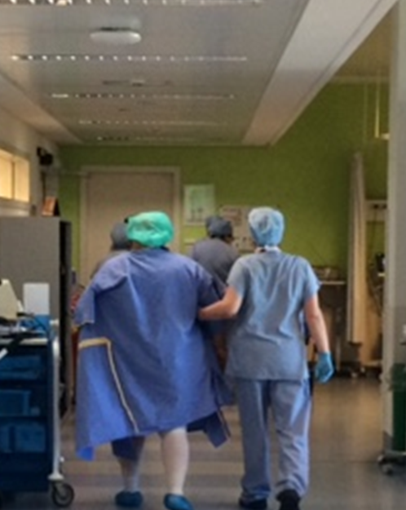
9538 Pts (8456 sleeve)
BMI 44.3 ± 3
F 74%
Age 40
OSAS (CPAP) 16%
Safe extubation within 2 minutes since the end of surgery independently from time&type of surgery and BMI (p 0,01)
No PORC
98% mobilization and fluid intake
within 30 minutes after extubation
Sent to the ward within 60 minutes
0,2 % Postoperative Intensive Care (ER-redo)
2,1 days average length of stay
82% Pain and PONV free
Lowering drugs prescriptions (-40%)

Slide 42

A standardized anesthetic pathway enhances the safe and efficient implementation of ERABS in a high volume center
Teamwork
Multiprofessional approach
Motivation & education
Patient and families involvement
Contact & strict follow up

Slide 43
Grazie
chiara.ferrari@humanitas.it

